Slide 1

Proof Of Concepts POC Performance Testing
Author
Satish Nath

Slide 2
Table of Contents
1 OVERVIEW… 3
1.1 Purpose. 3
1.2 Application Description. 3
2 POC APPROACH.. 3
3 KEY FINDINGS. 3
3.1 Feasibility. 3
3.2 Tools &license. 4
4 Test TOOL EVALUATION RESULTS. 4
5 CONCLUSION.. 4
Version | Date | Prepared By | Reviewed by
1.0 | 06/07/2024 | Satish Nath | Satish Nath
Notes:
ijnirjngiortnhitrs

Slide 3
1 OVERVIEW
1.1 Purpose
The purpose of this document is to detail the approach and outcome of the Proof-of-concept (POC) study done on the Quote Win and Supply Win application using Jmeter tool. Another wondering thing, this is an open-source tool so we don’t need to buy any license for calculated number of users like Load Runner.
1.2 Application Description
Jpet Store is a web based pet store which is an essential services retailer which sells animals,birds,reptiles,fish and pet care resources to the public. Citing convenience as the key motivational factor for purchasing from online pet stores, the number of United States households that shopped online for pet care products in 2018 was 13 million.[2] Other stated advantages for online shopping include competitive pricing and good value due to free shipping offers.

Slide 4
2 POC APPROACH
The objective of the Proof of concept exercise is to use jmeter tool to record and replay on the critical scenarios in scope and generate load from different load generators located at geographical regions(Not Applicable in Demo Application). Detailed below is the approach that was adopted for the POC exercise.
Sl No | Steps
1 | Understand Application Architecture and identify particular business flow(s) as a representative sample which includes as many complexities in the application as possible
2 | Test script to be created for the identified business flow (s) using Jmeter and web protocol. Ensure that parameterization and correlation is done wherever applicable
3 | Playback the script Individually for a single user for multiple iterations and ensure that the playback has committed the transaction fully as expected
4 | Execute a smoke test for 30 minutes using 2 users load and evaluate if there are any unexpected conditions arising in scenario
5 | Analyse the output presented including details of the statistics that are presented

Slide 5
3 KEY FINDINGS
3.1 Feasibility
Jmeter was able to successfully record and replay the Quote Creation flow in Product Costing.
3.2 Tools &license
Jmeter is a open source tool so no need to buy the licence .
4 Test TOOL EVALUATION RESULTS
The test results of the POC with Jmeter are attached below: –

Slide 6
5 CONCLUSION
Jmeter can be used to performance test the identified scenarios of Jpet Store application.
I have attached sample test results for reference please find below
Proof of concept (POC) Test Results
\
Date | 04/07/2024
Project | Jpet Store Performance Testing
Scenario | Shop pets online and create orders
Notes | Shop pets on Jpet Store flow was identified for POC. The Load is generated from Local Computer. Load Test is designed for 30 mins run duration with 5 users, in which 1 user will rampup for every 7 seconds and ramp down in the same way as ramp up i.e for every 7 seconds users start their ramp down

Slide 7
Summary Report
Time Stamp: – 07/07/2024 12:06:00 PM–12:36:00 PM (IST)
Scenario- Jpetstore_Shop_FishDog_POC
\

Slide 8
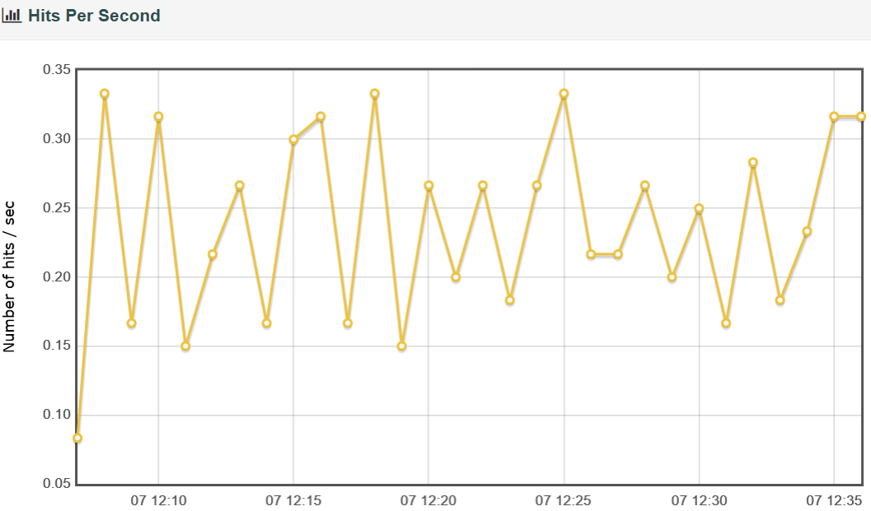
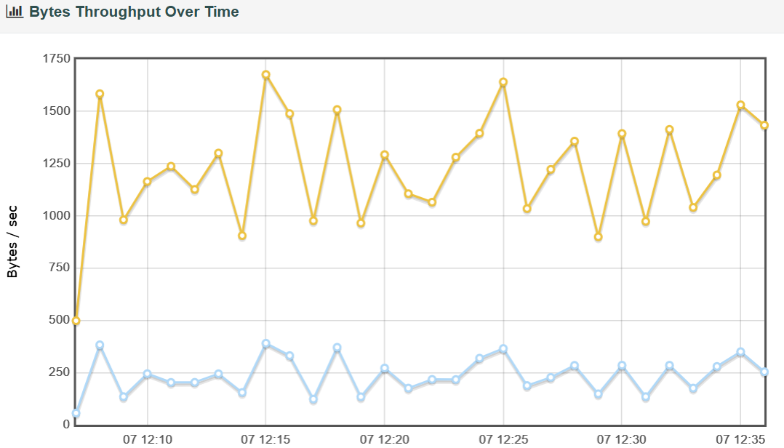
Hits Per Sec Graph
Throughput Graph

Slide 9
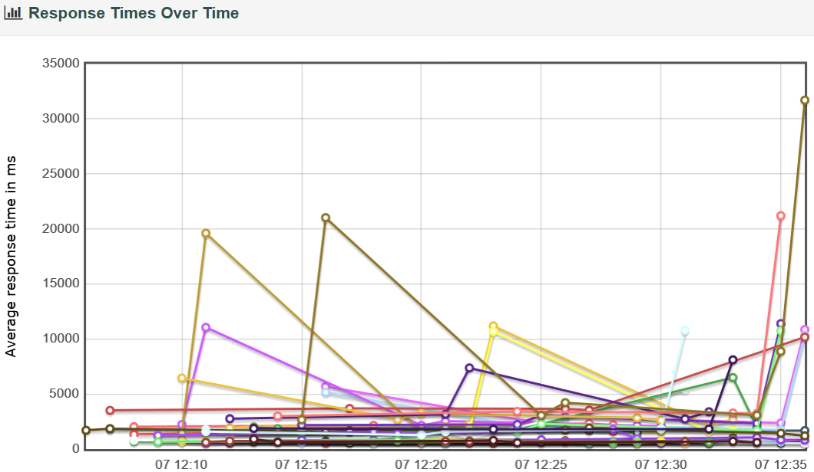
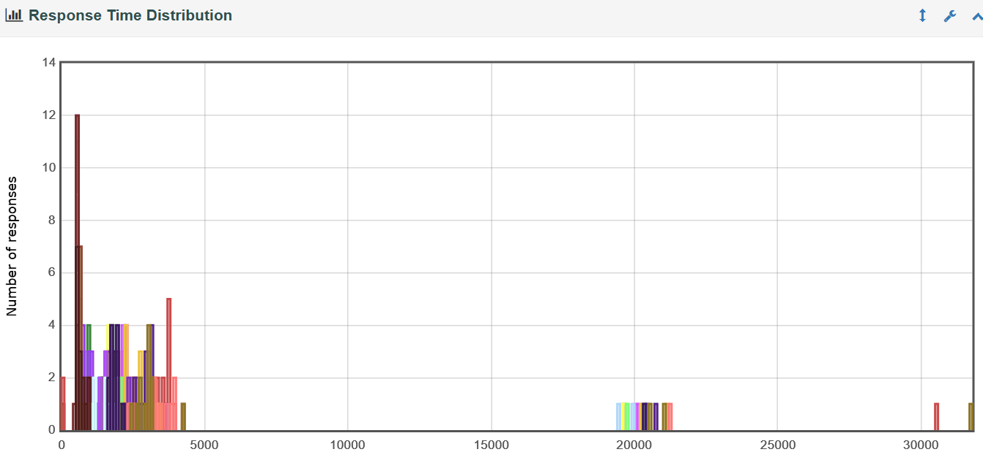
Response Time Graph
Response Time Distribution Graph

